Slide 1
Web app for private accommodation reservations
Albert Khaidarov
Enis Nuredini
Nedim Šišić

Slide 2
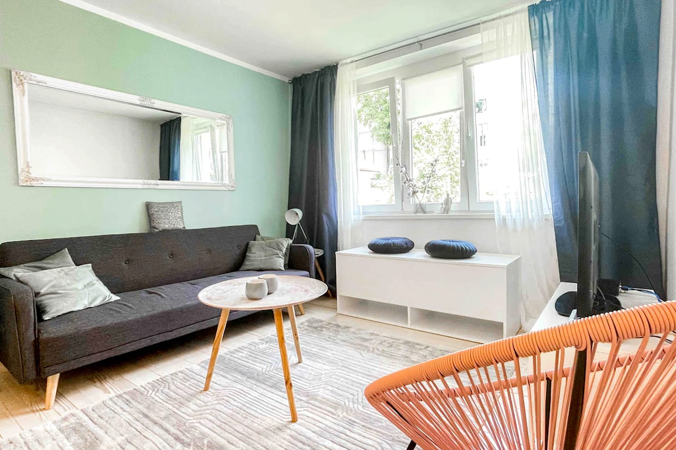
Motivation
Homestay - a private house offering accommodation to paying guests
Increasingly popular in the last decades
We want to build an app that allows users to find and book homestay reservations

Slide 3
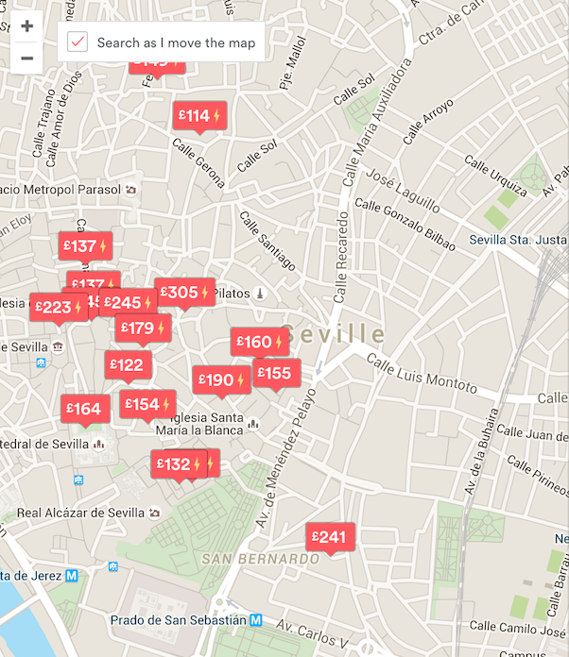
Features
Users will be able to:
Create an account
Search for and view accommodation offers
Make reservations
Use a map

Slide 4
Technologies
Option 1:
Ruby on Rails React

Slide 5
Technologies
Option 2: MERN stack

Slide 6
Technologies
Database options:
PostgreSQL
has great compatibility
highly scalable (serving up thousands of queries from hundreds of tables)
SQLite
more simple and robust
lets store data in a structured manner
MongoDB
Data stored as separate JSON files (enables to manage data of any structure)
Object-oriented database
fits to MERN/MEAN stack

Slide 7
Plan
Phase 1 - Analysis and Design
Requirements analysis All
Determining use cases All
Database design Albert, Enis
User interface sketch Enis, Nedim
April 12th

Slide 8
Plan
Phase 2 – Basic implementation
User registration Albert, Nedim
Basic CRUD, routing Albert, Nedim
Database Albert, Enis
Simple user interface design Enis, Nedim
End of April

Slide 9
Plan
Phase 3 – Refined implementation
Improving user interface
Improving CRUD, routing, etc.
Additional features
Middle of May

Slide 10
Plan
Phase 4 – Map
Incorporating the map feature
Phase 5 – Evaluation
Evaluation, testing, fixes
End of May

Slide 11
Thank you for listening!
Questions?

