Slide 1
Web app for Private Accommodation Reservations (PAR)
Albert Khaidarov
Enis Nuredini
Nedim Šišić

Slide 2
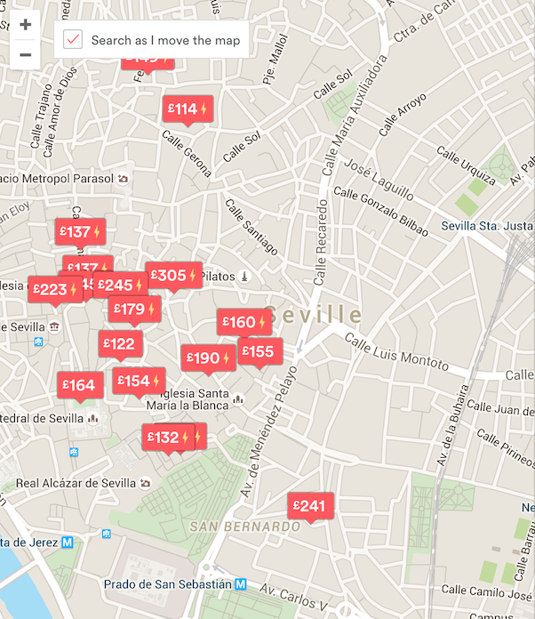
Features
Users will be able to:
Create an account
Make a room
Search for and view room offers
Make reservations
Use a map

Slide 3
Technologies
← Back End Front End →

Slide 4
Completed
Create an account
Manage Profile
Manage Room
Design

Slide 5
Plan
In Progress:
Adding photos to rooms
Making reservations
Then:
Searching for rooms
Map

